Slide 1
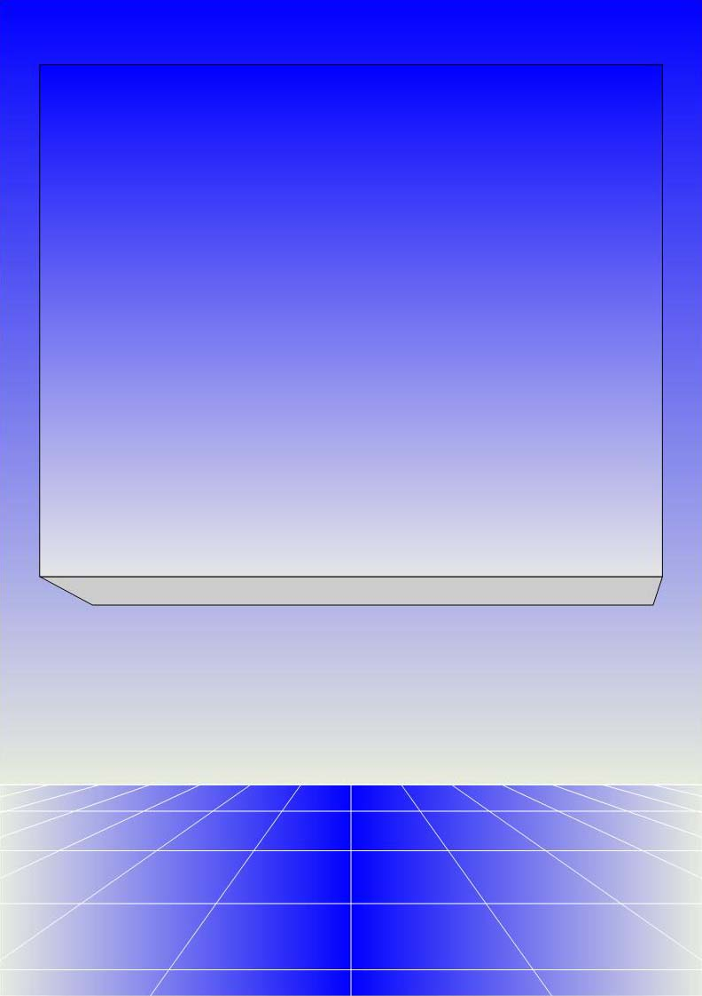
CO2402 - Advanced Programming with C++
Week 2 - Error handling, Exceptions
Gareth Bellaby

Slide 2

Topics
Reminders about last year.
Error handling and Exceptions.
The string class (if there's time).

Slide 3
Reminders about last year

Slide 4
Structures
Structures are a means for combining several related items which may be of different data types.
Can be treated as a single object.
Can also refer to the individual components of the structure.

Slide 5
Defining a Structure
struct person
{
char surname[200];
char firstname[200];
int age;
};
person fred;
fred.age = 27;
cout << person.surname;
strcpy(fred.firstname, "frederick";
cin.getline(fred.surname);
fred.firstname[0] = cin.get();

Slide 6
Arrays
Arrays are a technique for declaring many variables of the same type in one statement.
Able to consider the whole collection as a single object.
The individual elements of an array are accessed using a subscript (the number inside the square brackets).
Arrays always start at index 0 in C++.
int arr[5];
arr[0]; // the first element
arr[2]; // the third element
arr[4]; // the fifth element

Slide 7
Referencing array elements
float numbers[30];
int max = 0;
for(int i=0; i<30; i++)
{
if(numbers[i] > max)
{
max = numbers[i];
}
}

Slide 8
File output
Create a file stream
Open the file. This means associate the file stream with a physical file.
Check that the file has been opened successfully.
After use, close the file.

Slide 9
File output
ofstream outfile;
outfile.open("filename.txt");
// output file is created if it doesn't exist
//but what if the disk is full, for example?
if ( !outfile )
{
cout << “Cannot open output file\n”;
exit(1);
}
outfile << data1 << data2 << endl;
outfile.close();
For later: note that file streams are classes .

Slide 10
File input
Create a file stream
Open the file. This means associate the file stream with a physical file.
Check that the file has been opened successfully.
After use, close the file.

Slide 11
File input
ifstream infile;
infile.open("filename");
if( !infile )
{
cout << "Can't open input file\n";
exit(1);
}
while( !infile.eof() )
{
infile >> data1 >> data2;
}
infile.close();

Slide 12
Exceptions

Slide 13
Exceptions
When a program comes across something unexpected it can throw an exception.
Execution jumps to the nearest exception handling block.
The error handling block can do whatever it wants with the error: fix it, stop the program, ignore it, or pass it on perhaps with the assumption that another error handling block higher up will deal with it.

Slide 14
Overview
Three elements:
  try
  throw
  catch
The code to be checked is placed within a try block.
When an error occurs you throw an exception.
A catch block catches the exception and does what it wants with it.

Slide 15
Overview - code
try {
throw( 1 );
cout << "this line never reached\n";
}
catch ( int e )
{
cout << "Error handler" << e << endl;
}

Slide 16
Exceptions
One try block can have many catch blocks.
An exception can be of any data type.
It is the first catch() which matches the thrown data type which gets used.
For later: an exception can be an object. Indeed this would be the preferred data type for an error. We introduce exceptions using simple data types because they're easier to learn this way.

Slide 17
Different data types
try {
if( a == 0 )
throw( 1 );
else if( a == 2 )
throw( 'a' );
}
catch ( int e )
{
cout << "Catch int " << e << endl;
}
catch ( char e )
{
cout << "Catch char " << e << endl;
}

Slide 18
Exceptions
You can catch all exceptions by using an ellipsis in the catch() block, e.g. catch( ... )
An exception can be rethrown by the error handler (the catch block).

Slide 19
catch( ... )
int a;
cin >> a;
try {
if( a == 0 )
throw( 1 );
else if( a == 2 )
throw( 'a' );
else
throw( "everything else" );
}
catch ( ... )
{
cout << "Catch all errors " << endl;
}

Slide 20
rethrowing
try {
try {
throw( 0 );
}
catch ( int e ) {
if ( e == 0 ) {
cout << "dealt with";
}
else {
throw e; // not my error
}
}
}
catch ( int e ) {
cout << e << endl; // alternative handler
}

Slide 21
Exceptions and the stack
In normal operation if a function calls another function, the first is placed on the stack, e.g.
  f1 calls f2. f1 placed on stack, execution passes to f2.
  f2 calls f3. f2 placed on stack, execution passes to f3.
When an exception is thrown, it unwinds the stack. If an exception occurs it tries the local function, if not dealt with, unwinds to the next layer up, and so on.
This is extremely useful. A try block around the top-most function catches exceptions in the chain of called functions.

Slide 22
Uncaught exceptions
In the case of uncaught exception the program itself automatically calls the function terminate().
By default terminate() calls abort() which in turn shuts the program down. The debug window opens if you are in debug mode.
You can modify terminate() by registering an alternative function to abort() using the set_terminate() function.

Slide 23
C++ library
There are exceptions specified in the C++ library.
Dynamic memory allocation is performed using new.
If new fails, it throws a bad_alloc exception.
There is length_error for strings.

Slide 24
new + bad_alloc
int *ptr[50];
try {
for(int i=0; i<50; i++)
{
ptr[i] = new int[ 5000000 ];
}
}
catch ( bad_alloc &memoryException )
{
cout << "Exception ";
cout << memoryException.what() << endl;
}
Because of virtual memory please note that this code will cause your hard disk to work overtime!

Slide 25
Nested loops
If an error occurred, how would you cleanly break out of the middle of a nested loop?
for( int i=0; i<30; i++)
{
for( int i=0; i<30; i++)
{
// error here
}
}
break would only take you out of the middle block - which would lead to very messy code.
Throwing an exception provides a clean, simple solution.

Slide 26
Costs
When an exception is thrown, it unwinds the stack. This can be a lengthy operation, e.g. 100 milliseconds.
For example, for a game this might be 3 - 5 frames in length. Does this matter?
Depending upon the compiler implementation, exception handling will either incur a slight performance overhead or require extra memory.

Slide 27
Disadvantages
Costs were dealt with on the previous slide.
If overly used:
  Can become cumbersome.
  Can become difficult to read.
  Can become difficult to maintain.

Slide 28
Advantages
Does not lead to messy code. For example, a single block of code can be used for recovery in the case of a file error, even though a function chain has been created, multiple functions have been called, there are lots of different and unconnected things that could go wrong with a file read, etc.
Flexible approach.
Works up the chain of caller functions.
For later: Works with constructors and destructors.

Slide 29
When to use exceptions
Do not use exceptions as control structures!
  For example, the program prompts the user for a filename and then attempts to open the file. You do not use exceptions to deal with the possibility that the user has misspelled the filename.
In C++ normal programming constructs can be used to implement error handling.
Treat exceptions as being exceptional.
You should use exceptions, but use them sparingly and with care.

Slide 30
Strings

Slide 31
Use strings
c-type strings are 0 terminated character arrays.
They're great for teaching arrays.
I'll also need to go back to them when I look at multi-byte characters.
However, for normal use c-type strings have been superseded by the string class which is:
  much easier to use.
  far more robust (no worries around array size)
I want you to use the string class.

Slide 32
Strings
The string class is logical, e.g. you can assign data to it using the equals sign in the same way (for example) you do an integer.
The equality test is the double equals symbol.
Automatically resizes itself.
Lots of inbuilt functions.
The functions are invoked using the dot operator, e.g. str.length()
Need to include the string library
#include <string>
using namespace std;

Slide 33
Strings
string str;
string txt;
str = "hello";
txt = "bye";
cin >> str;
txt = str;
if( txt == str )
cout << "identical strings" << endl;
int n = str.find_first_of( "l" );
str.insert( 2, "ee" );
cout << str;
cout << str.length();

